Slide 1
A tale of two proposals, what went right, what went wrong
Richard Sanders
Senior Scientist
SINTEF ICT, Norway

Slide 2
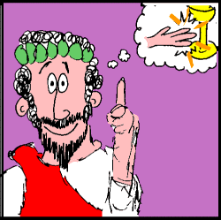
From Idea to Project: Story 1
The Story of MIDAS

Slide 3
MIDAS: The path to a submitted proposal
SINTEF
Initiative
2
Information Day
Brussels
Jan 2005
2 slides
1
4
IST Conference
Den Haag
Nov 2004
30 second presentation
Consortium meeting
Warsaw
Feb 2005
Start writing
3
Capgemini meeting
Utrecht
Feb 2005
Detailed discussions
Capgemini
“Digital Olympics”
Initiative
5
MIDAS Proposal Submitted
March 2005

Slide 4
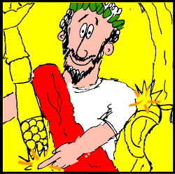
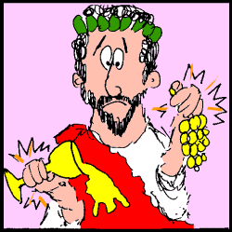
IST Conference, November 2004
1
Application Area - Clear (though limited):
  Support for emergency staff responding to major accident
Idea - Vague: “Mobility, wireless systems, data replication”
Consortium - Almost empty: SINTEF, maybe University of Oslo
IST Strategic Objective – Undecided: Try for “Mobile systems beyond 3G”; if that doesn’t work, try “ICT for Environmental Risk Management” in call 5
MIDAS advice:
Try to crystallize core technical idea at an early stage
Define partner roles, even though you don’t know their names yet
Decide on one strategic objective in the workprogramme, and go for it

Slide 5
Information Day, January 2005
2
Idea - Starting to emerge
Project description – Able to present 2 slides in 90 seconds, get idea across and contact numerous potential partners
Idea - Still not clear enough
Consortium – No progress (though some roles defined)
Application area – Starting to have doubts: is it too limited?
MIDAS advice:
Produce a concise 3-4 page summary of your project as early as possible, to help you:
  Clarify your own ideas
  Communicate project concept to potential partners and National Contact Points (NCPs)
  Write a”Project Abstract” – and give all readers a positive impression of the project

Slide 6
Capgemini meeting, February 2005
3
Consortium - Good impression of three potential partners; high-quality and relevant:
  Capgemini: Major system integrator
  Appear Networks: Dynamic SME specialising in mobile platforms
  51pegasi: SME specialising in mobile applications for sports
Idea - Full chaos when attempt integration with sports applications and new partner interests
Application area – Now convinced that mobile sports applications should be added to extend scope and applicability
MIDAS advice:
As you add new partners:
  Adopt some of their ideas; reject others
  Listen to all of them!

Slide 7
After Capgemini meeting (1):
Reducing Emphasis on Application Development
Extract from email from Commission Project Officer:
... I can remind you perhaps, that proposals ... must address generic networking issues and provide innovative new solutions to significant problems, even when exemplified by a sporting or emergency context. The application itself should not be the centre of gravity of the proposal.
Best regards
Andy Houghton
IST Brussels
MIDAS advice:
Always consult officials
  Earlier: Commission officials
  Now: National Contact Points (NCPs)

Slide 8
After Capgemini meeting (2)
Aspects of ”balance”:
  SMEs
  ”Big names”: organisations the evaluators will recognise
MIDAS advice:
Make sure that partners have ”real” roles – and significant effort allocation
Apply the ”delete a partner” rule of thumb
  If deleting partner X will not obviously jeopordise the consortium, is X really needed?
Individual partner descriptions must answer 4 key questions:
  Type of organisation
  Specific skills/techologies brought to the project
  Role in the project
  Interest in project results

Slide 9
Warsaw meeting, February 2005
4
Consortium - Balance starting to look good (though still some holes)
Idea - Still struggling to crystallize – though we know what activities and research we want to carry out
Application area – Settled on mobile sports applications and emergencies – but match with technical idea is unclear
MIDAS advice:
Unless key partners know each other well from previous co-operation: at least one meeting is essential to synchronise ideas

Slide 10
After Warsaw meeting
Consortium - Telefonica added as ”Leading European mobile operator” and RATP as end-user for mobile emergency crew application
Idea - Develop a platform that makes it commercially feasible for the wider IT industry (not just telecom companies) to develop distributed mobile applications, especially where there is a very large number of users, the service has to be set up at short notice or for a limited time period, and the availability of infrastructure is limited
Applications – Now clearly fit ”idea”; each addresses some common issues and some unique ones

Slide 11
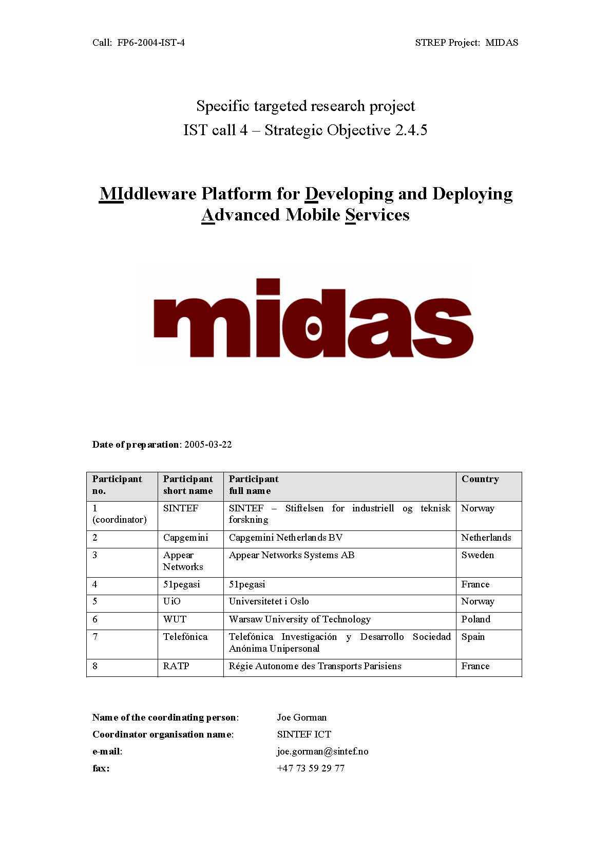
Proposal Submitted 22nd March
Evaluation results expected 14th June
5

Slide 12
And the story has a happy ending...
Evaluation results June 2005:
  Positive remarks from evaluators; only a few minor negative ones
  Scored 28 points out of 30. Few proposals manage this
Contract negotiations started August 2005
Project started January 2006

Slide 13
Paths that did not lead anywhere
SINTEF
Initiative
2
Information Day
Brussels
Jan 2005
2 slides
1
4
IST Conference
Den Haag
Nov 2004
30 second presentation
Consortium meeting
Warsaw
Feb 2005
Start writing
3
Capgemini meeting
Utrecht
Feb 2005
Detailed discussions
Capgemini
“Digital Olympics”
Initiative
5
MIDAS Proposal Submitted
March 2005
IP on “Semantic-based knowledge and content systems”
Other
Initiatives
Phone conferences with approx. 8 other research institutes/universities.
IP or STREP?

Slide 14

Story 2: Pluto’s downfall:
What went wrong with an EU proposal

Slide 15
Process: Linking consortium partners with core technical idea
Unclear idea, going several places at once
Core technical
idea
Partners
Partner roles not all directed towards common goal

Slide 16
Process: Linking application area with idea
Application
Area
Core technical
idea
Application area does not fully match proposal direction
Mis-match between concrete application and academic concept

Slide 17
Process: Linking partner with application
new partner
New partner matches application – but not other partners
Application
Area
Core technical
idea
Partners
Overall situation: proposal axes not synchronized

Slide 18
Process: timing, “normal”
Cummulative
effort
Text 40-60%
complete
Time
Internal
evaluation
Deadline
Approx. 3 weeks

Slide 19
Process: timing, PLUTO
Cummulative
effort
Text 2%
complete
Time
Internal
evaluation
Deadline
Approx. 3 weeks

Slide 20

Content: Clarity
“Reading this makes me give up the will to live”
(said by one of the co-authors of PLUTO during a phone conference)

Slide 21
Reasons for lack of clarity
Problems with overall quality of writing / structuring
Failure to separate:
  Input to project from partners' products & research
  Input to project from other projects
  What work will be done in the project
  Objectives
  Concrete results
  Impact: What becomes possible after the project

Slide 22
Types of Success & Failure
Success!!
“Harmless”
Failure
Harmful
“success”
Long-term
damage to
reputation by:
Score > ~12
but: undeserved
(problems when running project)
FUNDED
Score > ~12
Good proposal + project
Peers (evaluators)
Partners
NCP
Score 10-12
Score < 10
3 or more for each criterion
NOT
FUNDED
Score > ~12
But not funded anyway
Score < 10
Under 3 for some criteria

Slide 23
PLUTO: Signs of Failure
Score less than 10
Score less than 3 for criterion 1, criterion 3 (the ones most related to project concept)
Reviewer comments show:
  Not able to see any clear concept
  View proposal as “increment” on earlier work (because at least they can understand that...)
  Criticisms on details: “When evaluators feel unhappy with the clarity of the overall concept, it tends to annoy them and they find other things to complain about too.”

Slide 24
PLUTO: final error – failing to learn
“New call ... offers a great chance for PLUTO....”
“We can probably keep the focus in a new proposal”
“I think the reviewers were just looking for buzzwords”
“How do the reviewers know better than us how....”

Slide 25
From idea to proposal: axes
Vague
Core scientific/technical idea
Clear
Maybe know
approx. total
Budget
Takes account
of all partner rates
and wishes
Project
Idea
Project
Proposal
Incomplete/
unbalanced
Consortium
Complete/
balanced
Assume it will
be OK
Potential conflicts
addressed
IPR/
business aspects
Too vague or
too specific/
dominant
Drives technological development and enables
exploitation
Application area

Slide 26
Final Thoughts
Proceed with all technical and non-technical issues in parallel
Read and review: not just write
Nothing great is done without enthusiasm!

