Slide 1
ICT in H2020
In support of the EU digital policies
Khalil Rouhana
Director Components and Systems
DG CONNECT, European Commission

Slide 2
Overview
  Digital innovations: What is at stake?
  Where does Europe stand?
  What to do about it?
  Stepping-up our digital innovation capacities
    The essential role of H2020
  ICT in H2020: 2016-17 budgets and coverage

Slide 3

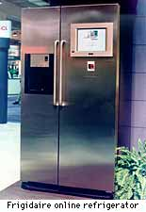
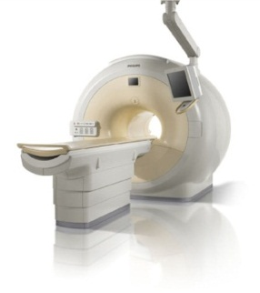
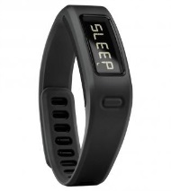


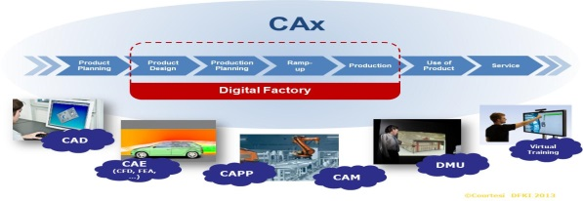



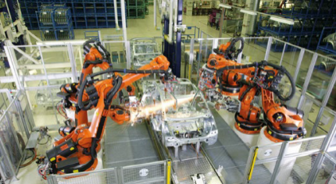

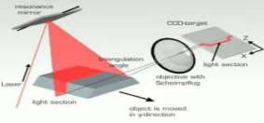
Three dimensions of digital value creation
"Digital inside": Innovations in products (all types)
~40 % AV growth
~50%
~40%
~80%
Digital transformations of processes
Radical/disruptive changes in business models
3

Slide 4














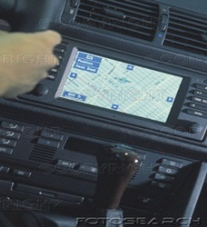
Digital value chains across all sectors
Critical Value chains
~40% of Added Value
~40% of Added Value
Electronics, photonics
ICTdevices
~40% of Added Value
~50% of Added value

Slide 5
Some figures
A potential 1 Trillion Euro added to GDP
  in the next 10 years from digitisation
Loss of 600 B€ of GDP per year if Europe lags behind
  If Europe is slow in in digital transformation
An annual 10 % increase in industry added value
  (Roland Burger for BDI 2015)
Up to an additional 1.5 trillion $ to US GDP by 2025
  (McKinsey for US admin)

Slide 6
Technologies driving the change
IoT
CPS, sensors, connectivity, low power…
Big data
Analytics, storage, Cloud, HPC servers ,..
Innovation in products, processes and business models
Digital
Transformation
AI
Robotics, automation, machine learning
6

Slide 7
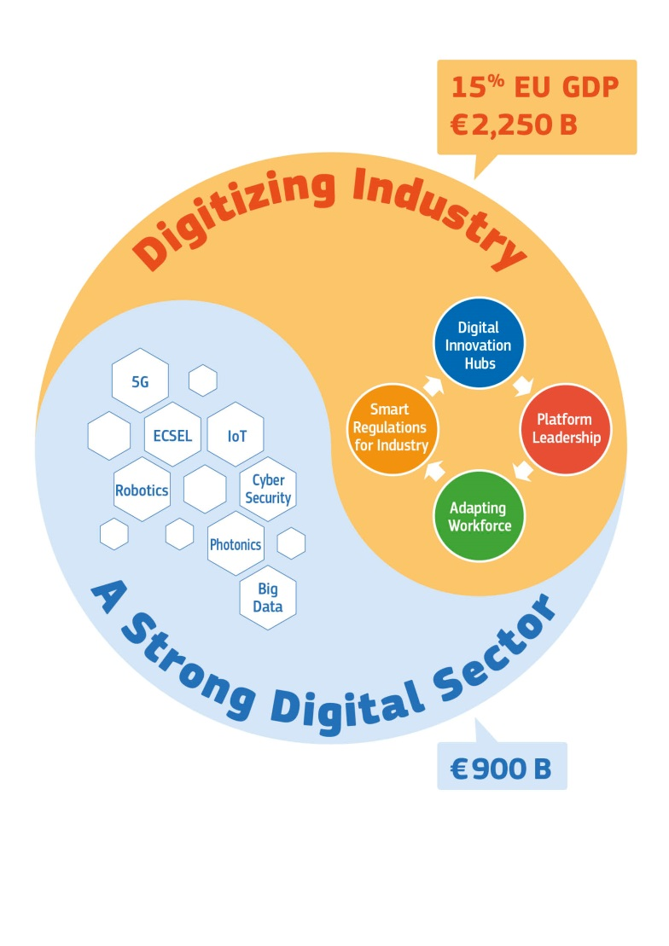
The challenge of digital transformation
Digital transformation
of all industry in Europe requires a strong digital sector in Europe
Broad digital transformation
of all industry offers a unique opportunity to strengthen
Europe's digital sector
Demand
Supply

Slide 8
Overview
  Digital innovations: What is at stake?
  Where does Europe stand?
  What to do about it?
  Stepping-up our digital innovation capacities
    The essential role of H2020
  ICT in H2020: 2016-17 budgets and coverage

Slide 9
Digital industry: Where does Europe stand?
Strengths
  Professional and vertical markets (products and services)
    Components, business software, Industrial and professional service robotics, automation, network equipment
  World class R&D hubs
  Good Telecom infrastructure, strong Telecom operators
  Size of EU market (~27% of world ICT market)
Weaknesses
  Consumer markets, Internet and web products and services
    From components to applications, Data platforms' ownership
  Structural weaknesses
    No DSM yet (substantial impact on attractiveness to investment including VCs, BAs, etc..)
    Lagging in investment in R&D

Slide 10
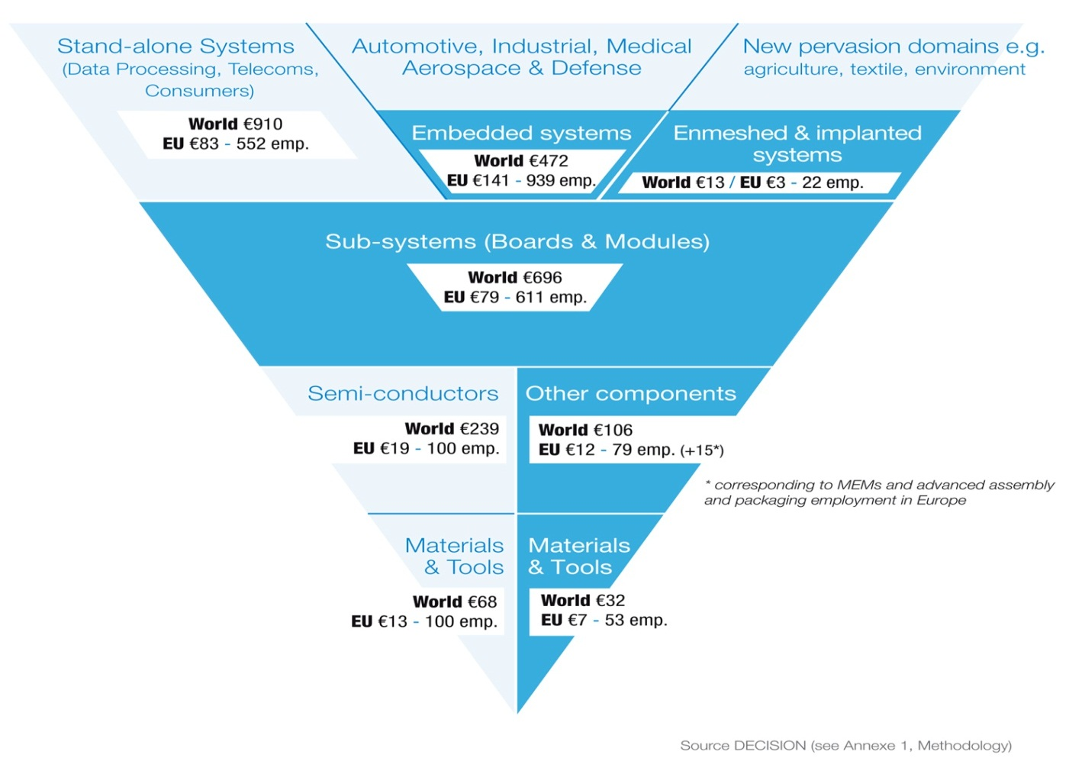

EU strengths and weaknesses: some figures
30 % of world production
<10 % of world production
11 % of world production
But
55% of automotive
> 50 % of energy and security
> 40% of automation/industry
Today 15 % of total
High growth areas
70 % of world production of "equipment"

Slide 11
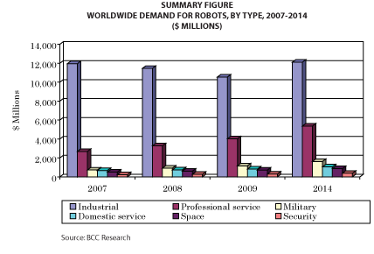
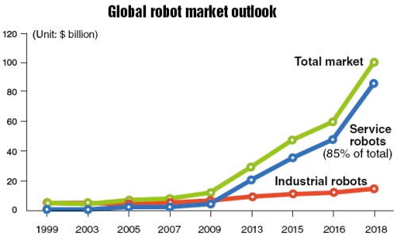
Where does Europe stand?
Robotics and autonomous systems
Industrial robotics:
coming back
Professional Service robots
"Steady growth", 15%/year
EU production in value:
~25 % of industrial robotics
~50 % of prof. service robotics
~<10% of consumer robotics

Slide 12
Digitising Industry:
The Digital Transformation Challenge
Strong digitisation in high tech industries, some MSs.
But:
  Slowness and disparities in adopting digital solutions across industries and regions
    Mainly SMEs and non tech sectors lagging behind
    Less than 2% of SMEs use advanced digital technologies
  New competition from non-EU internet/web industry
    e.g. Operating Systems, Web and Data platform owners
  Fragmented landscape of standards and lack of interoperable solutions
  Need for digital skills and re-skilling of work force
  Legislative and regulatory gaps

Slide 13
Digitisation readiness: disparities in Europe
Courtesy: Roland Berger

Slide 14
Overview
  Digital innovations: What is at stake?
  Where does Europe stand?
  What to do about it?
  Stepping-up our digital innovation capacities
    The essential role of H2020
  ICT in H2020: 2016-17 budgets and coverage

Slide 15
Pre-requisites
  A true Digital Single Market
    Proposed in May 2015
    Key issues for industry e.g.: free flow of data, standardisation, security
  World class digital infrastructure:
    Telecom infrastructure: CEF +DSM + ESIF
    Cloud and data infrastructure: HPC and Science Cloud initiative
  Easy access to finance:
    European Fund For Strategic Investments (EFSI) (>300 B€) European Structural and Investment Funds (ESIF),
    Horizon 2020
    National and regional programmes

Slide 16
Four lines of action
Stepping up our digital innovation capacities
  Access to latest technology
    To any industry in Europe (SMEs, mid caps, non tech, etc..)
    Bottom up spurring of digital innovations
  Partnerships for leadership in digital value chains & platforms
    From vertical markets to mainstream
Standardisation
  Prioritisation, Reference implementations, test, benchmarks
Adapting the legislation
  Eliminate barriers for digitisation
Preparing the human capital for the digital change
  Upskilling and rethinking the workplace

Slide 17
Our instruments
Financial:
  R&D&I instrument toolbox (Horizon 2020)
    Research projects, innovation actions, pilot lines, large-scale demonstrators, pre-commercial procurement, SME scheme, …
  + also
    European Structural and Investment Funds (ESIF)
    EFSI: "Juncker Package"
Leadership and coordination
  Stakeholder engagement, community building
  Political leadership to mobilise stakeholders, investors, policy makers
    Act as game changers e.g. 5G, "Airbus of chips, Digitising European Ind."
    Web entrepreneurs, start-up Europe, skills coalition, , etc..
Regulation
  DSM
  But also Energy, Health, transport, etc..
  State-Aid rules
    more favourable to investments
    European Important Projects of Common Interest

Slide 18
Overview
  Digital innovations: What is at stake?
  Where does Europe stand?
  What to do about it?
  Stepping-up our digital innovation capacities
    The essential role of H2020
  ICT in H2020: 2016-17 budgets and coverage

Slide 19
H2020: Main features
Biggest EU R&I programme ever
  €77 billion of EU funding over 2014-2020
  ~ 27% increase compared to 2007-2013
Core part of Europe 2020's strategy
  Smart, sustainable and inclusive growth
  Main objectives
    Responding to the economic crisis to invest in future jobs and growth
    Addressing people’s concerns about their livelihoods, safety and environment
    Strengthening the EU’s global position in research, innovation and technology

Slide 20
H2020:Three priorities
Excellent science
~30 %
Support to policy goals
Growth and jobs
Key societal challenges
Industrial leadership
Societal challenges
~21 %
~38 %

Slide 21
ICT in H2020 (not only LEIT-ICT)
Excellent Science
Frontier Research (ERC)
Future and Emerging Technologies (FET)
Skills and career development (Marie Skłodowska-Curie)
Research Infrastructures
25 % of ICT budget
ICT
ICT
20 % of ICT budget
Industrial Leadership
Leadership in enabling
and industrial technologies (LEIT)
ICT
Nanotech., Materials, Manuf. & Processing
Biotechnology
Space
Access to risk finance
Innovation in SMEs
Societal Challenges
Health, demographic change and wellbeing
Food security, sustainable agriculture,
and the bio-based economy
Secure, clean and efficient energy
Smart, green and integrated transport
Climate action, resource efficiency,
and raw materials
Inclusive, innovative and reflective societies
Secure societies
ICT
ICT
ICT
ICT
55 % of ICT budget
ICT
ICT
ICT
ICT
ICT
21

Slide 22
ICT in H2020: Ambitious targets
Establish/maintain a competitive "core" ICT industry to support the whole economy and address the societal challenges
"Quantified" targets, e.g.:
  20% of value creation of Components by 2020-2025
    Up from around 10% today
  Maintain value creation in Photonics at ~20% by 2020
    ~20% today but under big pressure
    Ensure wide deployment of SSL , 20% of reduction of energy in lighting
  Capture market growth in robotics and ensure wider deployment
    By 2020: ~25% of industrial robots, ~50% of professional, ~20 % of consumer
  Maintain Europe's strong position in embedded software and sys
    30% of value creation from embedded systems in Europe
  Seize the 1 Trillion euro opportunity fro digitising industry…

Slide 23
ICT in H2020: approach
Capitalise on strengths in professional markets
  to capture new growth areas in mainstream markets
  Recover from missed opportunities in the Internet economy
Work in partnerships
  PPPs as EU–wide ecosystems for innovation & business growth
Address the whole value chain and innovation chain
  R&D&I providing differentiating factors across value chains
  Supply-demand interaction, multiple stakeholders
  SMEs as key players
Connect to national and regional policies
  Pool resources, align strategies, Links to regional hubs
  Triggering ESIF support
Combine policy instruments to achieve goals
  Access to finance, EFSI, State aid, standards, Skills, outreach
  Links with other fields ( in LEIT, societal challenges and FET)
Delivery, delivery, delivery, …

Slide 24
Coupling research to innovation
Support to Research and Innovation from lab to market
  All forms of innovation:
    Support to SMEs, experimenting, benchmarking, Pilot Lines, PCP/PPI, Access to technology and finance,.. ….
  Set of instruments: RIAs and IAs
Closer relationship between R&I and entrepreneurship
More "open and simple schemes" in support of SMEs
More evaluators from businesses involved in the selection process
About half of the budget of ICT-related activities allocated to instruments aiming at supporting innovation

Slide 25
Work in Partnerships
Contractual PPPs
  Involvement of industry in the preparation of WP
  Dual commitments to invest: Indicative pre-defined budget
  More emphasis on relevance of industry and impact
  Open to all according to normal FP rules
Joint Technology Initiatives
  Industry driven research agenda
  Fixed budget for 7 years to leverage more industry investment
  Coverage of longer value chains and interrelated sectors
  Higher level of SME participation
  Specific solutions outside FP rules
Complemented in ICT by an Open (disruptive) scheme

Slide 26
Partnerships in ICT
Joint Technology Initiatives
ECSEL (Electronic Components and Systems for European Leadership)
  1,185 b€ from EU (250m€ in 2014-15)
  3,6 b€ (out of which 1,2 b€ from Member States) from industry partners and other sources
Contractual PPPs
5G → 700m€ indicatively earmarked in H2020 (125m€ in WP2014-15)
Photonics → 700m€ (156m€ in WP2014-15)
Robotics → 700m€ (157m€ in WP2014-15)
High Performance Computing → 700m€ (157m€ in WP2014-15)
Factories of the Future (ICT part) → 450m€ (102m€ in WP2014-15)
Big Data → 500m€ (not in WP2014-15 )
++in the making cybersecurity

Slide 27
The EU added value of the cPPPs, across the value chain
+Demand led actions e.g. in EIPs
Industry - academia- EC- Public sector
Co-engagement to support roadmaps to reinforce/build leadership
More than 23 B€ of investments: Can go up to ~5 B€ from ICT in LEIT

Slide 28
Connection to national and regional actions
Pooling resources into common initiatives when needed
  The JTI ECSEL
  ERANETs
  Art 185: AAL
"Competence centres" based initiatives
  I4MS, ECHORD++, "Smart anything everywhere",..
Guidelines for combining funds from ESIF and H2020

Slide 29
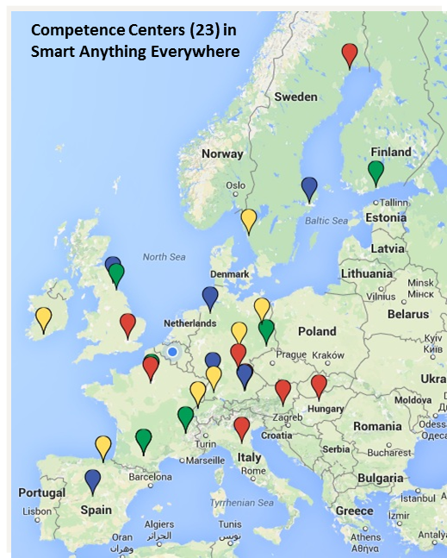
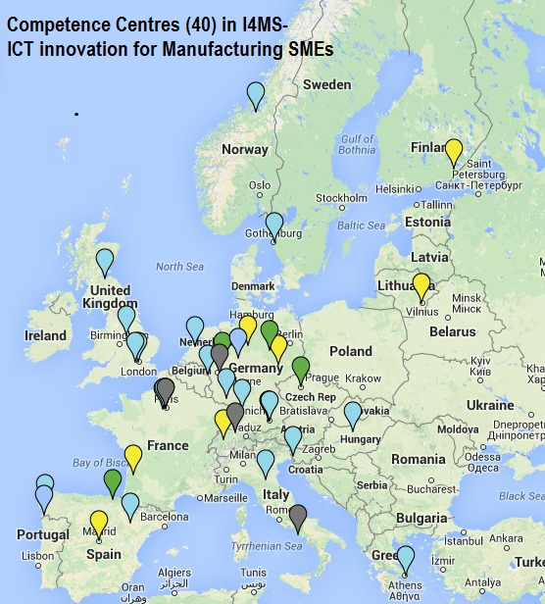

Connecting to regional & national actions/ strategies: steering a wave of Bottom up innovation, SMEs start ups, etc..
under the Factories of the Future
Smart Anything Everywhere under Components & Systems
Status (EU support so far):
~150 M€ (2013-14)– 14 projects – 80 centres – 400 experiments
~75 M€ in 2015 (in contracting phase)
29
Notes:
Main charachteristics of the schemes are
The initiative is build around a pan-Euopean network of competence centres (typically research organisations, universities)
These centers provide expertise and skills in the advanced technology
They support the technology transfer and act as innovation multipliers through active dissemination of best practices
Typical project structure is IP and in H2020, large Ias in order to have a critical mass of experiments.
The focus is on industrial SMEs / mid-caps with experiments that include the whole value chain in a flexible partnerships (only for the time of the experiment usually 12-18 months max) and a funding that can vary between 50K and 250K EUR.
What is shared within the consortium is not the IPR which stay within the partners of the experiments, but the leasson learnt.
The implementation of these schemes is flexible and light (especially in H2020) and allow for Open Calls for new experiments and the funding is distributed in cascade to third parties by the coordinator.
So the experiments partners will not become Beneficiaries anymore which allow less administrative burden and faster procedures.

Slide 30
Overview
  Digital innovations: What is at stake?
  Where does Europe stand?
  What to do about it?
  Stepping-up our digital innovation capacities
    The essential role of H2020
  ICT in H2020: 2016-17 budgets and coverage

Slide 31
ICT in 2016-17
Excellent science
820 M€
1900 M€
Industrial leadership
Societal challenges
> 460 M€

Slide 32
ICT LEIT: 2016-17
Excellent science
1900 M€
Industrial leadership
Societal challenges

Slide 33


Industrial Leadership – ICT 2016_17
A new generation of components and systems:
    engineering of advanced embedded and resource efficient components and systems
Next generation computing:
    advanced and secure computing systems and technologies, including cloud computing
Future Internet:
    software, hardware, infrastructures, technologies and services
Data and Content technologies
    Data analytics, ICT for digital content, cultural and creative industries
Robotics and AI:
    robotics and smart spaces
Micro- and nanoelectronics and photonics:
    key enabling technologies
84 M€ + ECSEL (120)
71 M€
253 M€
278 M€
164M€
181 M€ + ECSEL (180
+ 225 for IoT and FoF
+156 for SMEs
33

Slide 34

Components and systems
2016-2017
84 M€
(+ 120 M€ in ECSEL)
Cover systemic integration from smart integrated components to cyber-physical systems
Complementary to the JTI Electronic Components and Systems (ECSEL)
Organised in four topics:
    Smart cyber-physical systems (20 M€)
      Next generation embedded and connected systems
    Thin, Organic and Large Area Electronics (20 M€)
    Smart system integration (18,5 M€)
      Integration of heterogeneous micro- and nanotechnologies into smart systems
    Smart Anything Everywhere initiative (25,5 M€)
34

Slide 35

Advanced Computing and Cloud Computing
2016-2017
71 M€
Reinforce and expand Europe's industrial and technology strengths in low-power ICT
Foster the evolution of Cloud technology to increase its uptake
Complementary to the work in the Excellent Science pillar under Research Infrastructures and FET (on High Performance Computing)
Organised in two topics:
    Customised and low energy computing (26 M€)
    Cloud Computing (45 M€)
35

Slide 36

Future Internet
2016-2017
253 M€
Integrated response to technology challenges and innovation needs of the future Internet
Organised in seven topics:
    5G PPP Research and Validation of critical technologies and systems (103 M€)
    5G PPP Convergent Technologies (45 M€)
    Networking research beyond 5G (18 M€)
    Software Technologies (31 M€)
    Future Internet Experimentation - Building a European experimental Infrastructure (26 M€)
    Collective Awareness Platforms for Sustainability and Social Innovation (10 M€)
    Net Innovation Initiative (20 M€)
    5G PPP
    (148 M€)
36

Slide 37

Data and Content technologies
2016-2017
278 M€
Improve access, creation, management and use of data and content through advances along the data, content and knowledge value chains.
Organised in eleven topics (+ one prize):
    Big data PPP (153 M€)
      Cross-sectorial and cross-lingual data integration and experimentation (54 M€)
      Large scale pilots in sectors best benefitting from data-driven innovation (50 M€)
      Research addressing main technology challenges of the data economy (31 M€)
      Support, industrial skills, benchmarking and evaluation (7 M€)
      Privacy-preserving big data technologies (9 M€)
      Big Data inducement prize (2 M€)
    Media and content convergence (39 M€)
    Tools for smart digital content in the creative industries (17 M€)
    Support technology transfer to the creative industries (14 M€)
    Technologies for Learning and Skills (31 M€)
    Interfaces for accessibility (12 M€)
    Gaming and gamification (12 M€)
37

Slide 38
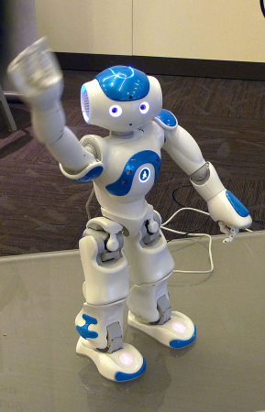
Robotics and autonomous systems
2016-2017
164 M€
Technology-driven actions to keep EU at the cutting edge of research + market-driven actions to accelerate take-up and deployment of robots
Roadmap-based approach
 Robotics PPP
Organised in four topics in LEIT-ICT + one topic in SC2:
    Advanced robot capabilities research and take-up
    (64 M€)
    System abilities, development and pilot installations
    (42 M€)
    System abilities, SME & benchmarking actions, safety certification (46 M€)
    Robotics competition, coordination and support (5 M€)
    Robotics Advances for Precision Farming (7 M€) (SC2)
38

Slide 39
ICT key enabling technologies
2016-2017
181 M€
Translate Europe's S&T excellence in photonics and micro- and nano-electronics into strengthened competitiveness and market leadership
Address the whole research and innovation value chain in photonics technology: from materials to manufacturing, products and services, through equipment and devices – from advanced R&D to pilot lines
 Photonics PPP (153 M€)
 Complemented by activities of LEIT-NMBP and FoF PPP
Cover generic technology developments on micro- and nano-electronics focused on exploratory research and lower Technology Readiness Levels (TRLs) (23 M€)
    Complementary to the JTI Electronic Components and Systems
  Organised in three topics in LEIT-ICT + one in LEIT-NMBP
  + one in FoF
39

Slide 40
ICT for the Factories of the Future
2016-2017
116 M€
Part of the 'Industry 2020 in the Circular Economy' cross-cutting focus area
Focus on ICT components of innovative production systems in all sectors (for a more personalised, diversified and mass-produced product portfolio and for rapid and flexible reaction to market changes)
Implementation of the FoF PPP
Organised in three topics:
    Digital automation (53 M€)
    ICT Innovation for Manufacturing SMEs (I4MS) (33 M€)
    Photonics laser-based production (30 M€)
40

Slide 41

Internet of Things
2016-2017
139 M€
Cross-cutting focus area
    Contributions from SC1 and SC2
Increased support with the ambition
to foster the take-up of IoT in Europe and
to enable the emergence of IoT ecosystems
supported by open technologies and platforms
Organised in three topics:
    Large scale pilots (100 M€)
      Smart living environment for ageing well
      Smart farming and food security
      Wearables for smart ecosystems
      Reference zones in EU cities
      Autonomous vehicles in a connected environment
    IoT Horizontal activities (4 M€)
    R&I on IoT integration and platforms (35 M€)
41

Slide 42

Digital Security
2016-2017
118 M€
Focus area
    Combining contributions from LEIT-ICT, SC1 and SC7
Grouping the main R&D&I activities in digital security, from enabling technologies to specific use cases
Organised in eight topics:
    Cryptography (18,5 M€)
    Assurance and Certification for Trustworthy and Secure ICT systems, services and components (23,5 M€)
    Addressing Advanced Cyber Security Threats and Threat Actors (18 M€)
    Privacy, Data Protection, Digital Identities (18 M€)
    Cyber Security for SMEs, local public admin. and individuals (22 M€)
    Economics of Cybersecurity (4 M€)
    EU Cooperation and International Dialogues in Cybersecurity and Privacy Research and Innovation (3 M€)
    Increasing digital security of health related data on a systemic level
    (11 M€)
42

Slide 43
Innovation and Entrepreneurship support
2016-2017
156+ M€
Reinforce the involvement of users in R&D&I
Support digital entrepreneurship
Strengthen the support to start-ups and SMEs
Facilitate the meeting between investors and start-ups
Increase the entrepreneurial skills
Organised in five topics + inducement prizes:
    Startup Europe for growth and Innovation Radar (12 M€)
    Innovation procurement networks (4 M€)
    Pre-commercial procurement open (4 M€)
    Open Disruptive Innovation scheme – SME instrument (126 M€)
    Fast Track to Innovation (100 M€ - for all fields of LEIT and SCs)
    ICT Horizon prizes (10 M€)
43

Slide 44
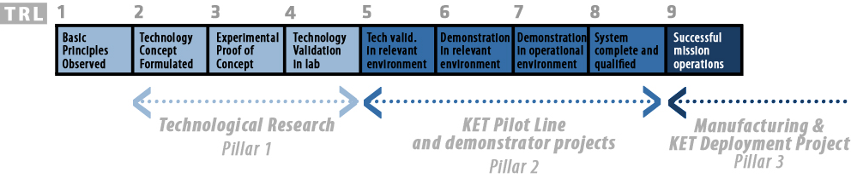
ECSEL: Covering the whole ECS value chain
Focus on high TRLS
Implementation in JTI
Capital-intensive R&D&I,
Pilot lines,
Demonstrators / Applications
Intensity of investment
Industrially-driven R&D
Pan-European Innovation:
Take-up,
Assessment,
Infrastructure,
Design services
Implementation
in normal H2020
Advanced R&D

Slide 45
ICT in Excellent science
820 M€
Excellent science
Industrial leadership
Societal challenges

Slide 46

Excellent Science - ICT
624 m€*
Future and Emerging Technologies (FET)
    FET Open: fostering novel ideas
    FET Proactive: nurturing emerging themes and communities
    FET Flagships: pursuing grand interdisciplinary science and technology challenges
        Graphene
        Human Brain Project
Research infrastructures
    Developing the European research infrastructure for 2020 and beyond
      Development, deployment and operation of ICT-based e-infrastructures
        ICT infrastructure resources and services for Research
        Access to and management of scientific data
        High Performance Computing
        * Including budget for other areas than ICT covered in FET
196 m€

Slide 47

Future and Emerging Technologies
2016-17
624 M€
FET Open (259,5 M€)
    Still open to all radically new technologies in all areas
    Introduction of FET Innovation Launchpad (3 M€)
      stimulate innovation by initiating entrepreneurial activities around results from FET research projects
FET Proactive (180 M€)
    Boosting emerging technologies (95 M€)
      Introduction of FET ERA-Net cofund actions
      (generic + specific on Quantum technologies)
    High Performance Computing (85 M€)
      Part of HPC PPP / complementary to eInfra and LEIT-ICT activities
  FET Flagships (185 M€)
    Continuation of Graphene and Human Brain Project flagships
    Launch of an ERA-Net cofund for partnering projects in both flagships
47

Slide 48

Research Infrastructures
2016-17
eInfrastructures (122 M€)
    Support the European policies on open research data, data and computing intensive science, research and education networking, high-performance computing and big data innovation.
      Integration and consolidation of e-infrastructure platforms
      Prototyping innovative e-infrastructure platforms and services for research and education communities, industry and the citizens at large
  European Open Science Cloud for Research (10 M€)
    pilot action that should demonstrate how wide availability of scientific data and data-analysis services for European researchers can be ensured through a cloud infrastructure
  GEANT (64 M€)
  Interactive Computing e-infrastructure for the Human Brain Project FET Flagship (25 M€)
48

Slide 49
ICT in Societal challenges
Excellent science
Industrial leadership
Societal challenges
460 M€
49

Slide 50

Budget
SC | 2014-15 | 2016-17 | 2014-2020 (w/o EFTA) | Total SC (w/o EFTA) | % earmarked for ICT
Health | 268 | 232 | 1 018 | ~ 6 900 | 15%
Food | - | - | - | ~ 3 700
Energy | 72 | TBD | TBD | ~ 5 400
Transport | 85 | TBD | TBD | ~ 5 850
Environment | 25 | TBD | TBD | ~ 2 750
Societies | 78 | 85 | 319 | ~ 1 200 | 26%
Security | 99 | 98 | 384 | ~ 1 550 | 25%
Total | 627 | 415 | 1 903+ | ~ 27 350 | 7%
Note: All budget figures in M€
↓ Different approaches between SCs!
50

Slide 51

Health, demographic change and wellbeing
2016-2017
  Personalized Medicine (114,5 M€)
    Active ageing and self-management of health (58,5 M€)
      PCP - eHealth innovation in empowering the hospitalised patient (18 M€)
      PPI for deployment and scaling up of ICT solutions for active and healthy ageing (10,5 M€)
      EU-Japan cooperation on novel ICT Robotics based solutions for active and healthy ageing at home or in care facilities (5 M€)
      Personalised coaching for well-being of older persons (25 M€)
    Methods and data (56 M€)
      In-silico trials for developing and assessing biomedical products (19 M€)
      Personalised computer models and in-silico systems for well-being
      (19 M€)
      Big Data supporting Public Health policies (10 M€)
      PPI for uptake of standards for the exchange of digitalised healthcare records (8 M€)
  Coordination activities (9,5 M€)
51

Slide 52

Inclusive, innovative and reflective societies
2016-2017
  Four calls
    Co-creation for growth and inclusion (ICT: 30,5 M€)
      Applied co-creation to deliver public services (10 M€)
      Policy-development in the age of Big Data (11,5 M€)
      Once-only principle (9M€)
    Reversing inequalities and promoting fairness (ICT: 4 M€)
      Multi-stakeholder platform for enhancing youth digital opportunities
      (1 M€)
      Boosting inclusiveness of ICT-enabled research and innovation (3 M€)
    Understanding Europe (ICT: 35,5 M€)
      Virtual museums and social platform on European digital heritage,
      memory, identity and cultural interaction (11 M€)
      European cultural heritage, access and analysis for a richer
      interpretation of the past (9 M€)
      Understanding the transformation of European public administrations
      (15,5 M€)
    Engaging together globally
52

Slide 53
Security
2016-2017
    Digital Security focus area (118 M€)
      Privacy and Data Protection (18 M€)
      Addressing Advanced Cyber Security Threats and Threat Actors
      (18 M€)
      Cyber Security for SMEs, local public administration and Individuals (22 M€)
      Economics of Cybersecurity (4 M€)
      EU Cooperation and International Dialogues in Cybersecurity and Privacy Research and Innovation (3 M€)
      Increasing digital security of health related data on a systemic level (SC1) (11 M€)
      Assurance and Certification for Trustworthy and Secure ICT systems, services and components (LEIT-ICT) (23,5 M€)
      Cryptography (LEIT-ICT) (18,5 M€)
    Critical infrastructure protection (40 M€)
      Prevention, detection, response and mitigation of the combination of physical and cyber threats to the critical infrastructure of Europe
      (40 M€)
53

Slide 54

Find out more
Horizon2020 web site
  http://ec.europa.eu/programmes/horizon2020
Participants portal
  http://ec.europa.eu/research/participants/portal
H2020 Helpdesk, including FAQ
  http://ec.europa.eu/research/index.cfm?pg=enquiries
National Contact Points
  http://ec.europa.eu/research/participants/portal/desktop/en/support/national_contact_points.html
54

Slide 55
THANK YOU
Digitsing European Industry
http://ec.europa.eu/digital-agenda/en/digitising-european-industry

